Slide 1
Interpretable ML Approaches for Golf Swing Analysis
Sol Thiessen
September 16, 2025

Slide 2
Outline
Introduction
Methods
Results
Discussion

Slide 3
Outline
Introduction
Methods
Results
Discussion

Slide 4
Objective
Build a system to provide automated coaching feedback to golfers
How?

Slide 5
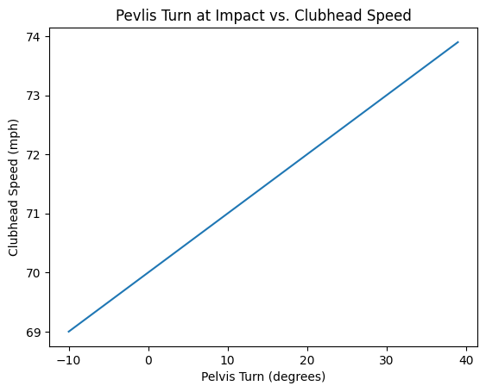
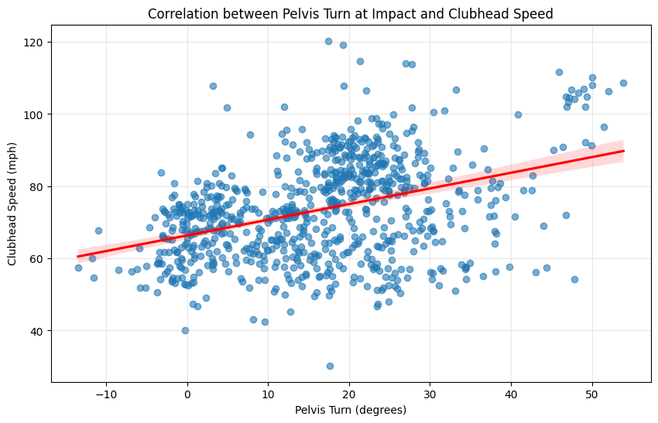
Traditional Statistical Modeling
Hand craft an interpretable parameterized model and infer parameters from data e.g. linear regression
Relationships between features and outputs must be assumed a priori
Limited family of functions available
Assumed Model
How the data looks…
lv

Slide 6
Our Approach
Learn a strong black-box predictive model and reverse engineer it to obtain feature effects
Model
Kinematic data:
Segment angles
Segment displacements
Swing outcome:
Carry distance
Spin rate
Deviation from target line
Interpretability (what caused this prediction?)

Slide 7
Outline
Introduction
Methods
Results
Discussion

Slide 8
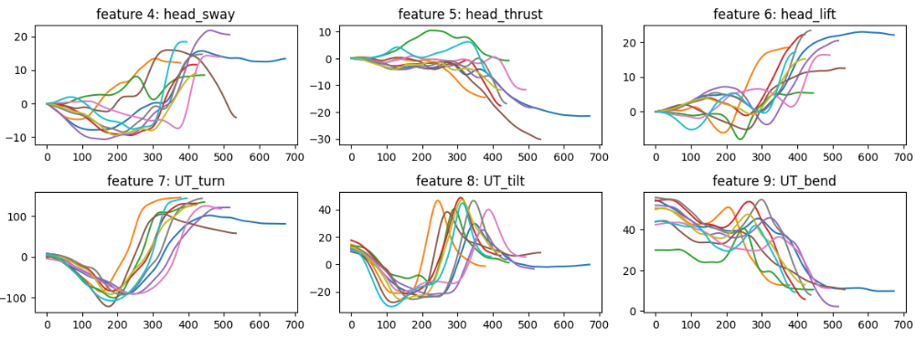
Data
Time-series kinematic and kinetic measurements

Slide 9
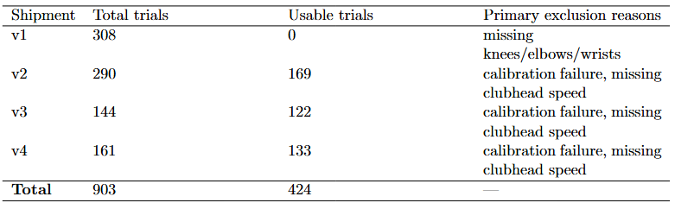
Data

Slide 10
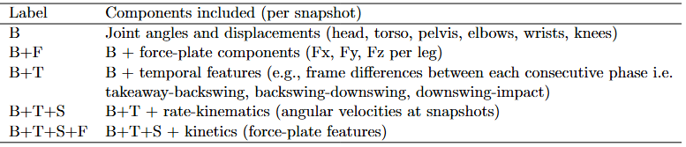
Feature Sets

Slide 11
Pipeline
Featurization
Standardization
VIF filtering
Time-series features
Tabular features
(Dimensionality reduction)
Model prediction
Prediction

Slide 12
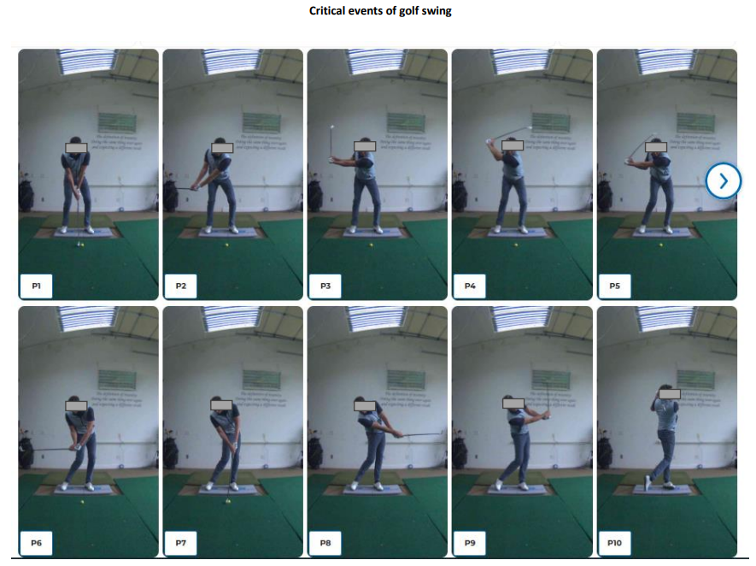
Featurization

Slide 13
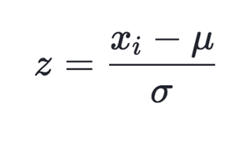
Standardization

Slide 14
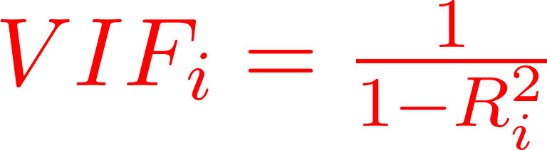
VIF filtering
Recursively compute and drop highest VIF feature until the highest VIF is below the threshold (VIF < 5)

Slide 15
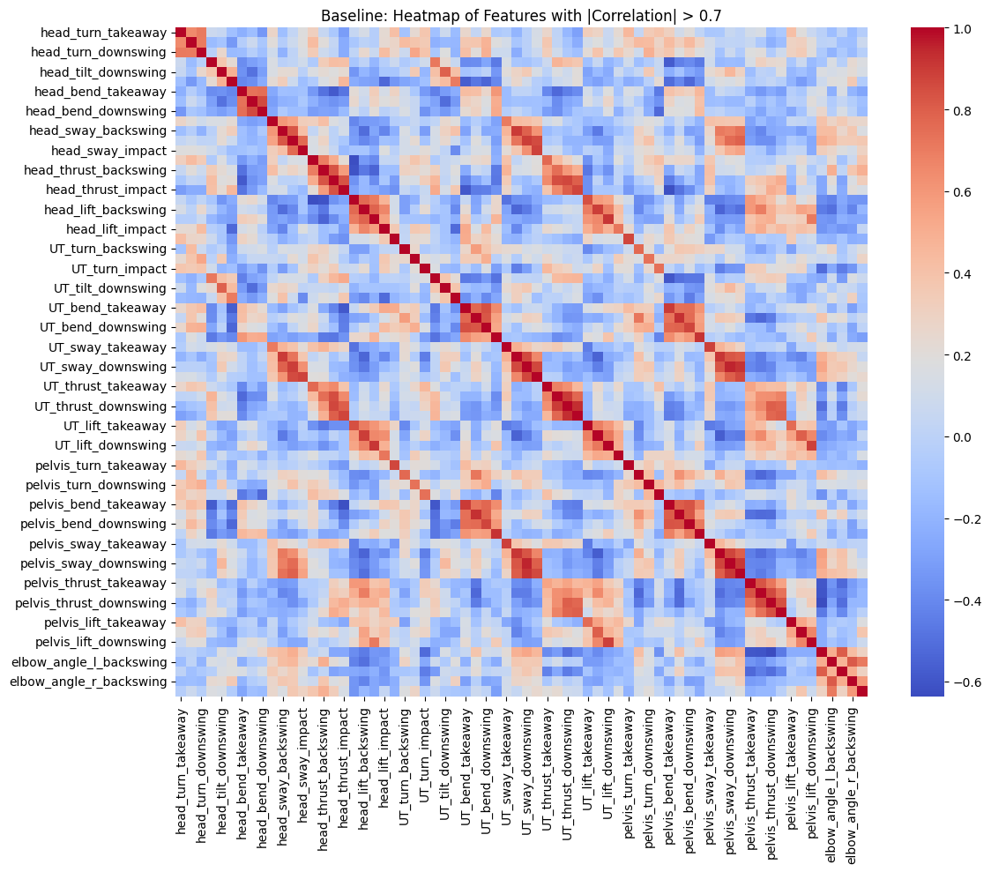
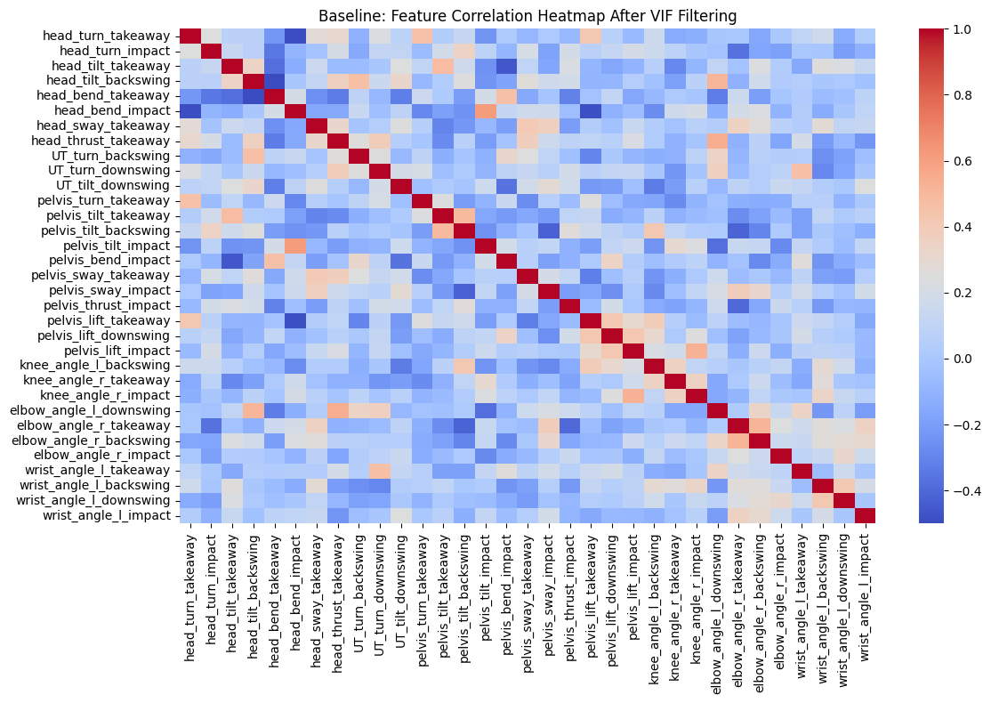
VIF filtering

Slide 16
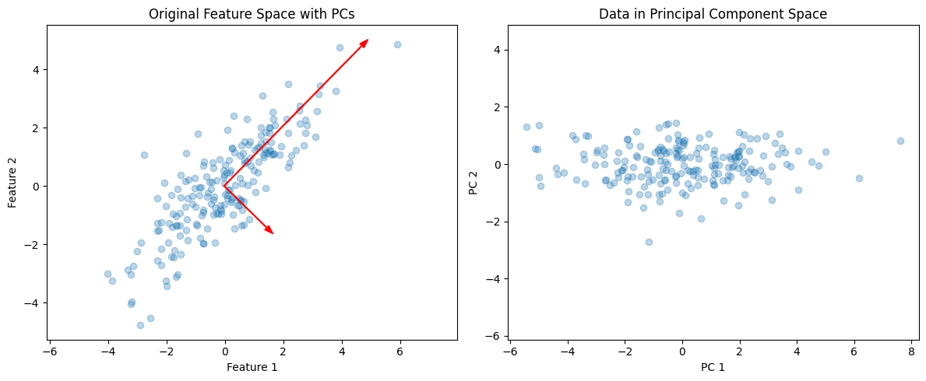
Dimensionality Reduction: PCA

Slide 17
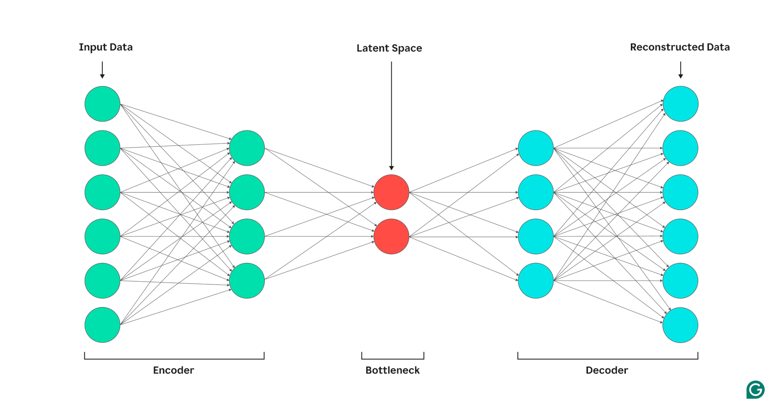
Dimensionality Reduction: Autoencoder

Slide 18
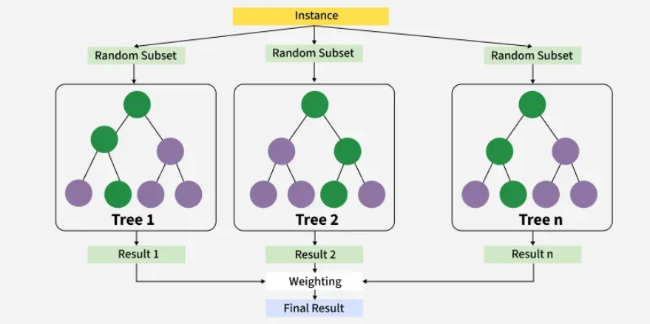
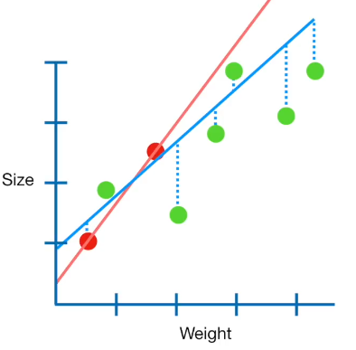
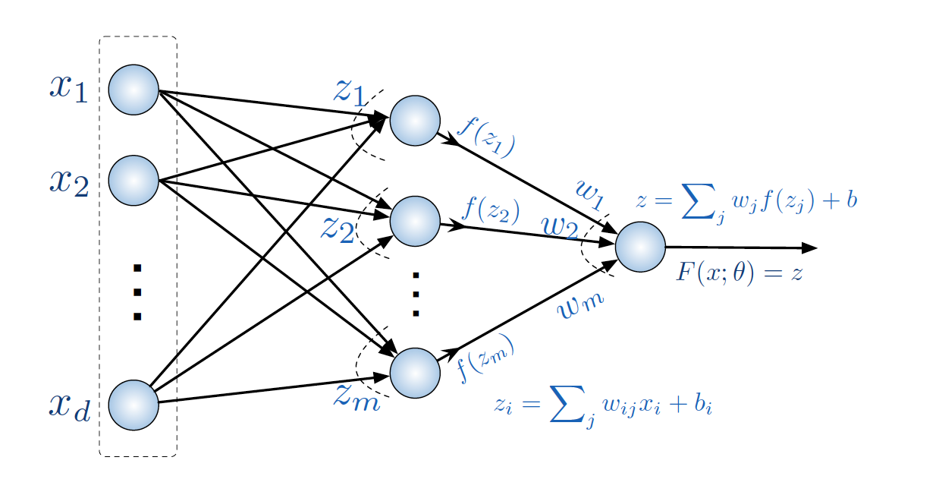
Models
Ridge Regression
FCNN
XGBoost

Slide 19
Models: Ensemble by Voting
XGBoost: 15
Ridge: 21
FCNN: 18
0.4
0.1
0.5
17.1

Slide 20
Models: Ensemble by Stacking
XGBoost: 15
Ridge: 21
FCNN: 18
Meta-learner
18.3

Slide 21
Neural Network Regressor
Input
hidden_dim
Prediction
num_layers
Layer
dropout
linear
BN
ReLU

Slide 22

Decoder
Reconstructed
input_dim
Encoder
Input
num_encoder_layers
num_encoder_layers
bottleneck_dim
input
num_encoder_layers
Neural Network Regressor
hidden_dim
Prediction
num_layers

Slide 23
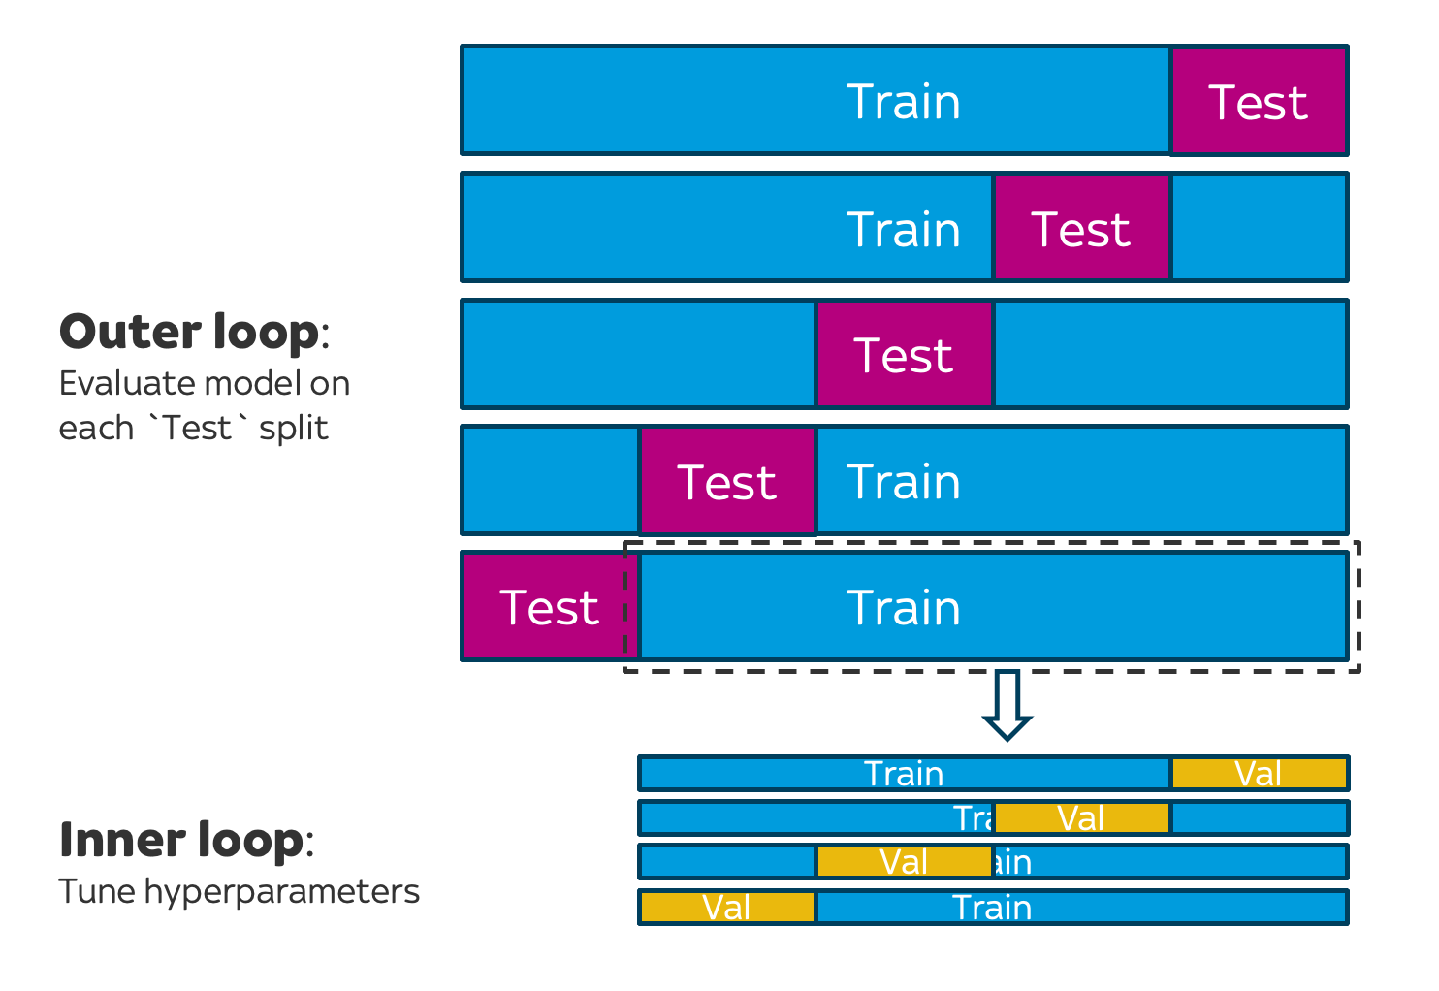
Nested Cross-Validation
Splitting:
Uniformly random over data
Group by user ID

Slide 24
Outline
Introduction
Methods
Results
Discussion

Slide 25
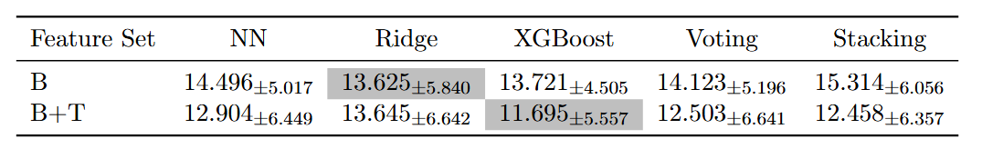
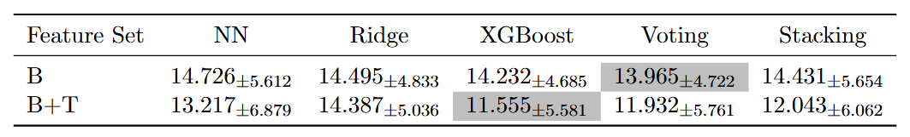
GroupKFold
No DR
DR

Slide 26
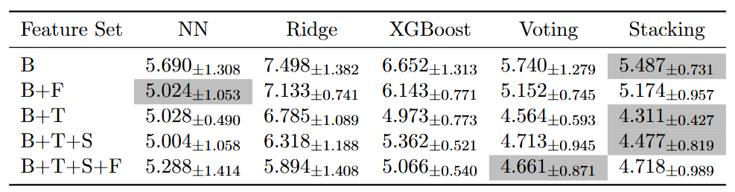
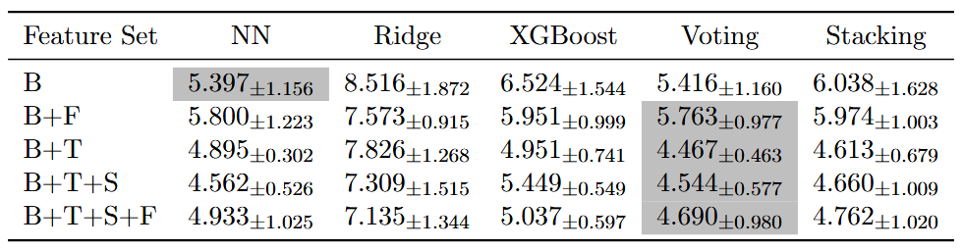
Trial-wise KFold
No DR
DR

Slide 27
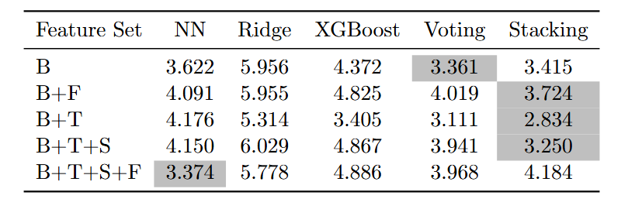
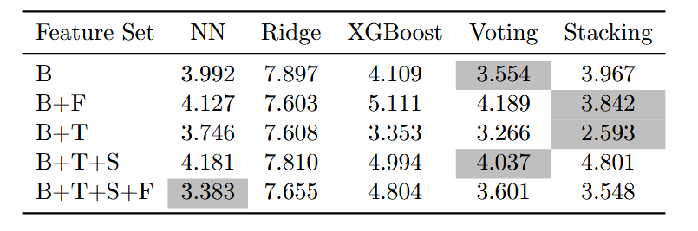
Trial-wise Kfold: Retrained on Final 90/10
No DR
DR

Slide 28
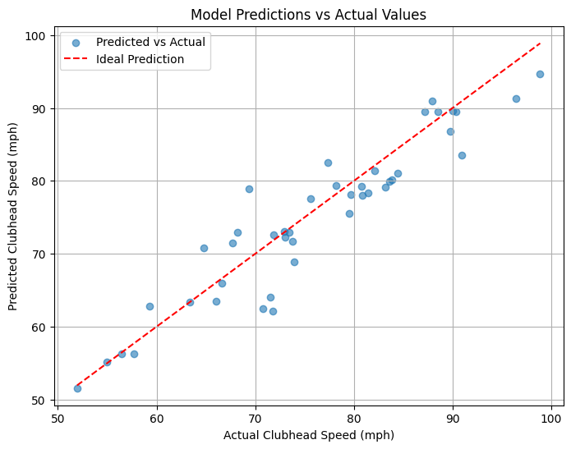
Interpretability Techniques: Performance

Slide 29
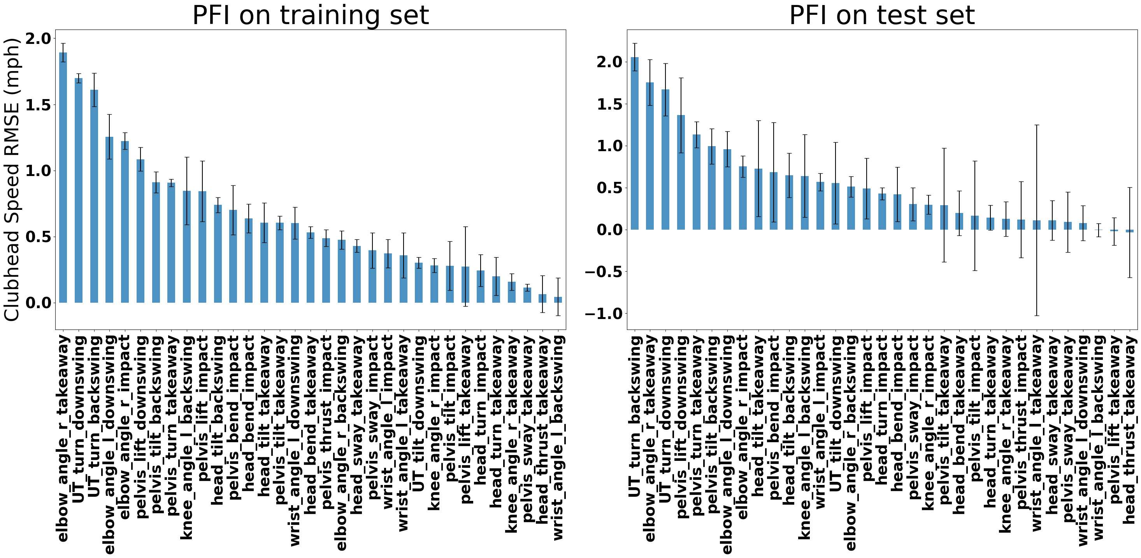
Interpretability Techniques: Permutation Feature Importance

Slide 30
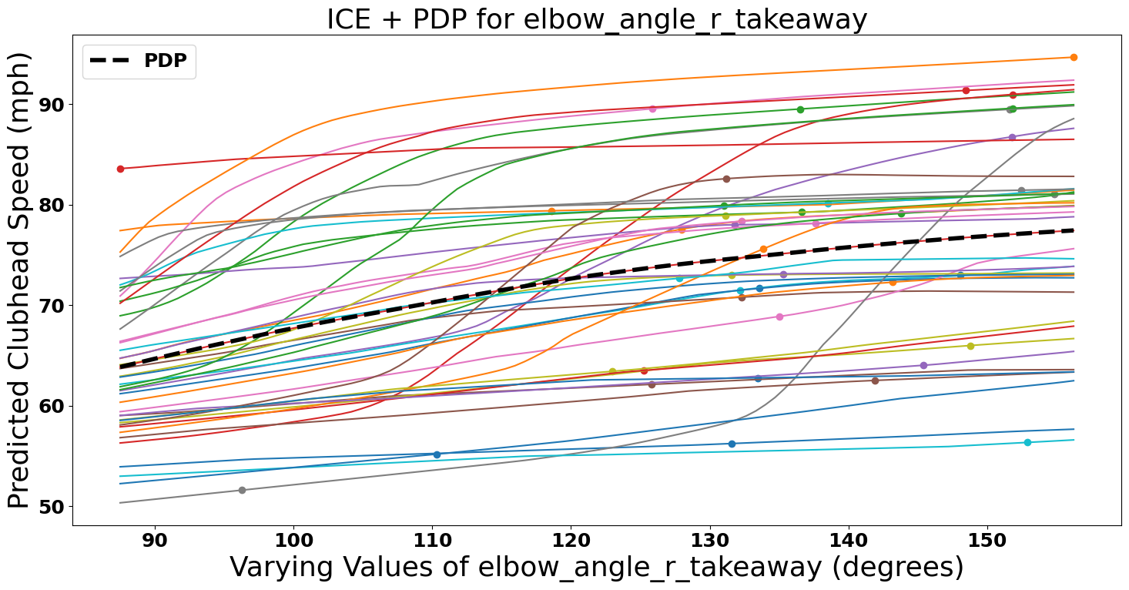
Interpretability Techniques: ICE and PDP

Slide 31
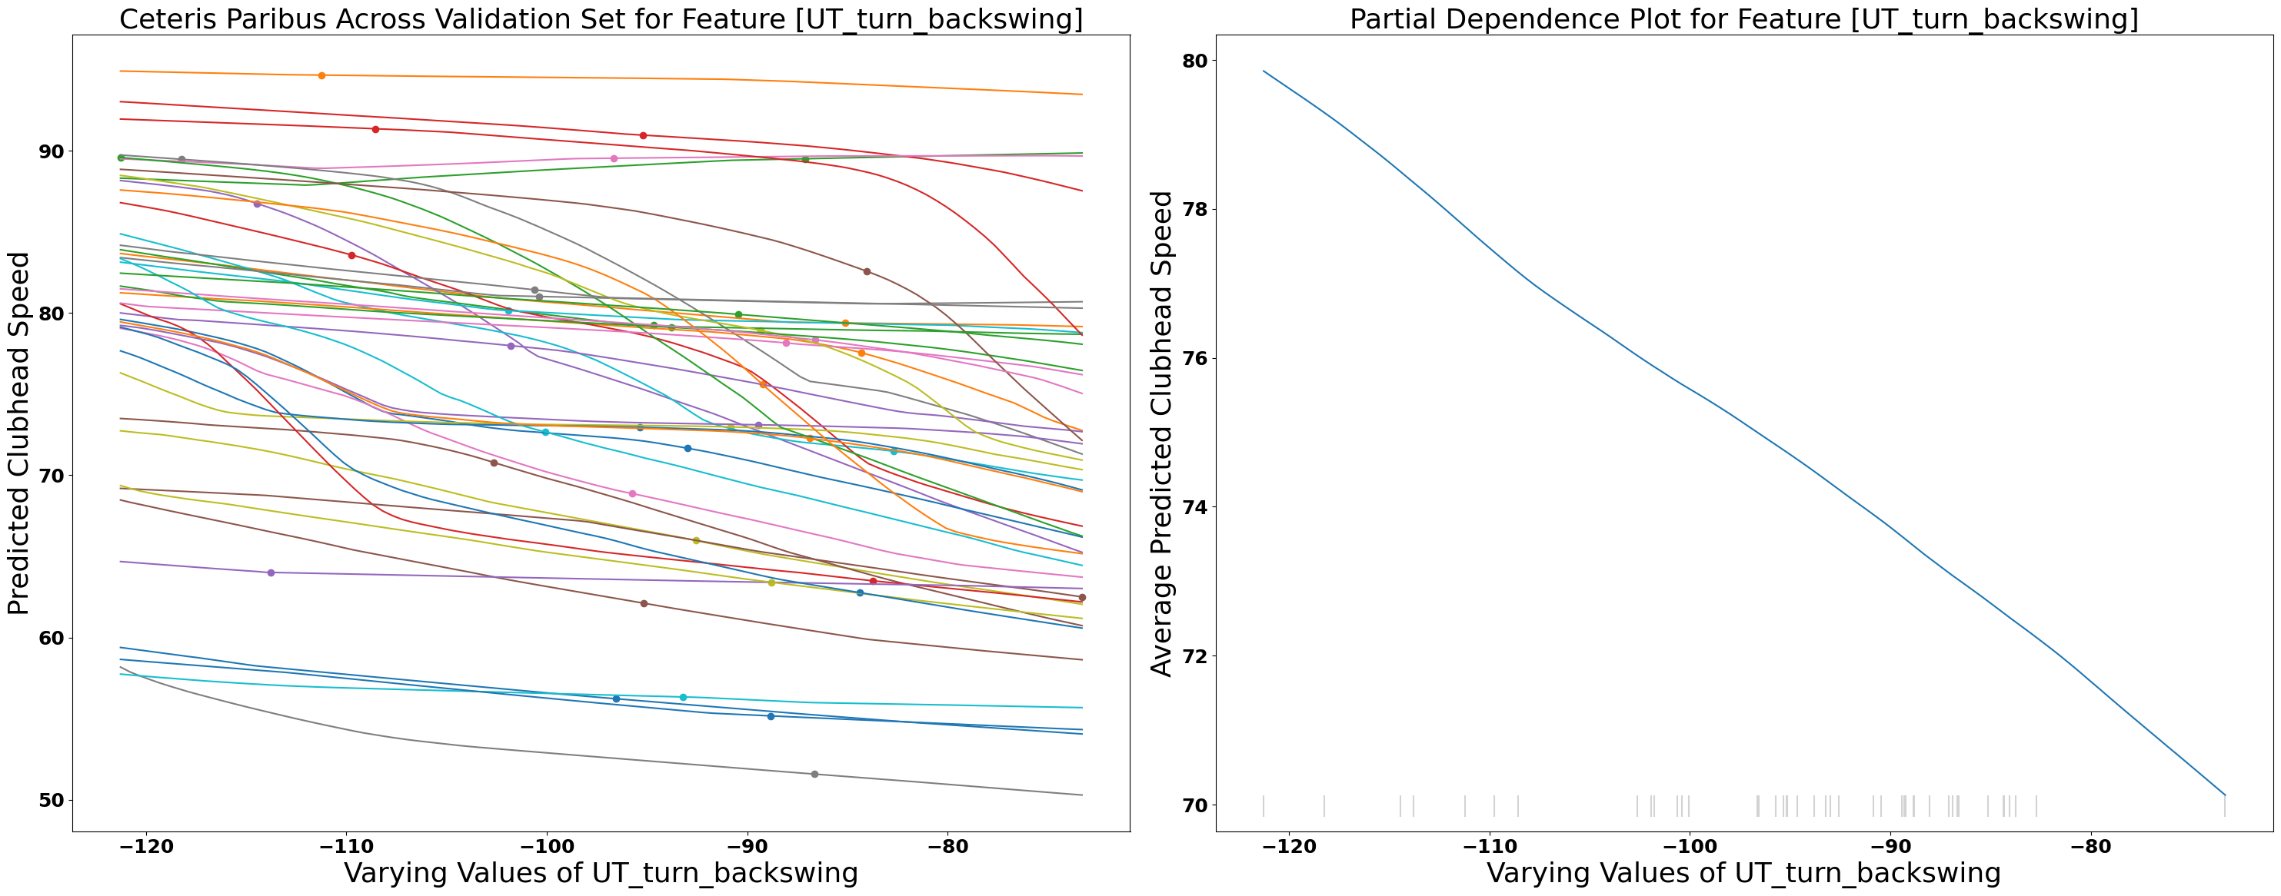
Interpretability Techniques: ICE and PDP

Slide 32
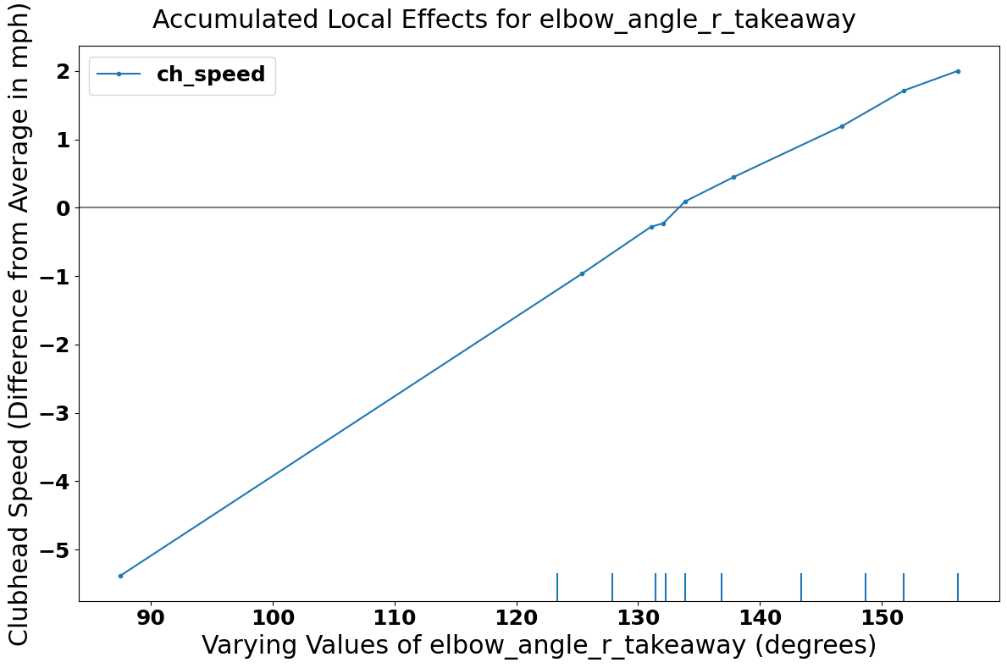
Interpretability Techniques: ALE

Slide 33
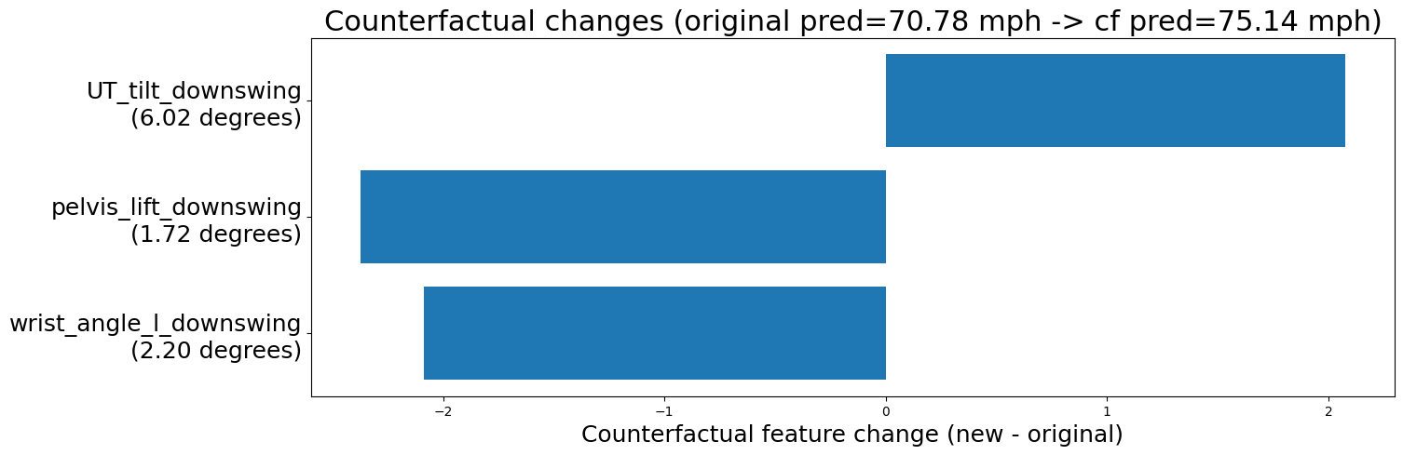
Interpretability Techniques: Counterfactual

Slide 34
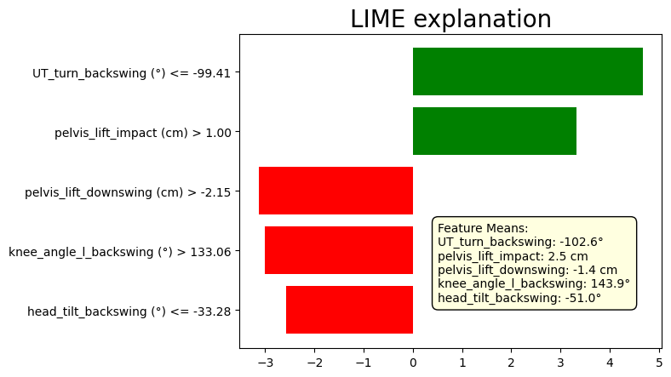
Interpretability Techniques: LIME

Slide 35
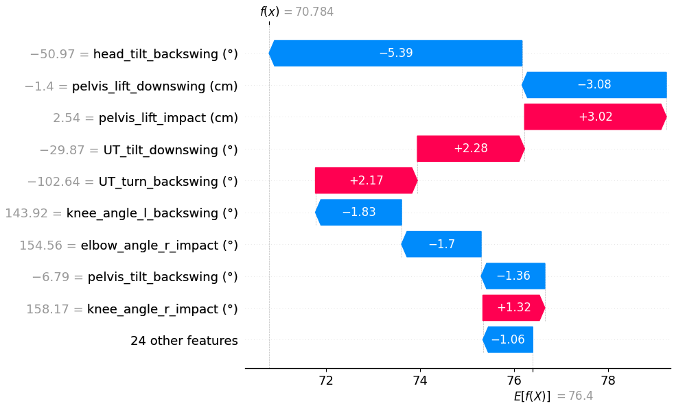
Interpretability Techniques: SHAP

Slide 36
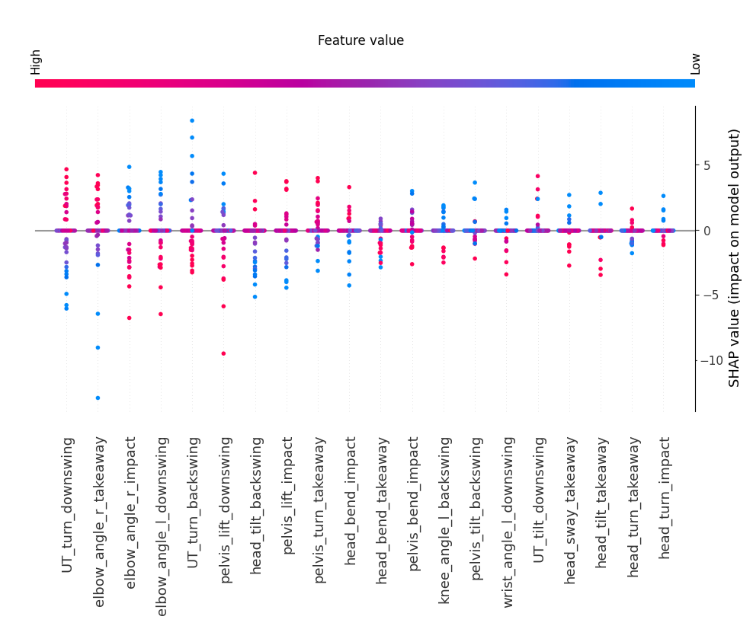
Interpretability Techniques: SHAP Summary

Slide 37
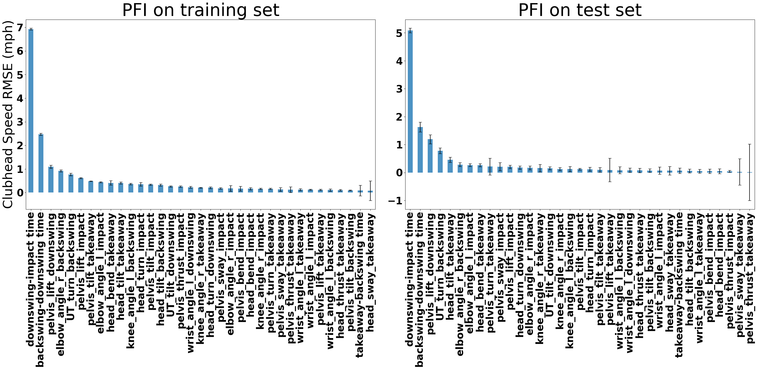
What about for a model with temporal features?

Slide 38
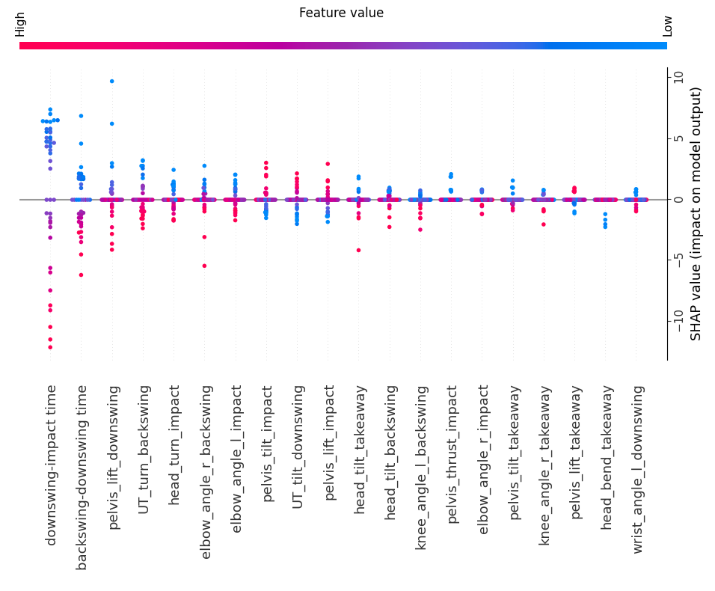
What about for a model with temporal features?

Slide 39
Outline
Introduction
Methods
Results
Discussion

Slide 40
Feature set trade-off
Temporal features provide the best predictive performance with poor explanation capacity
This problem is specific (somewhat) to clubhead speed
Baseline feature set balances accessibility (no forces) and mechanistic insights
Surprisingly strong predictive performance despite being time-agnostic

Slide 41
Limitations
Data, data, data
Need more to span input space (of elite and amateur golfers)
Need better labels (anthropometrics, skill, club type, outcomes)
Interpretation stability
Single model subject to variance (^)
Poor inter-user generalization
Loss of information
Dropping of correlated features

Slide 42
Outlook
Data, data, data (again)
Validate explanations in an interventional study
Translate model feedback into coaching feedback i.e. drills etc.
Integrate with musculoskeletal modeling software
Ensure feasibility of proposed changes
Visualize swing changes

Slide 43
Conclusion
We CAN predict golf swing outcomes from static kinematic features alone
Black-box interpretability methods appear to provide solid mechanistic explanations for swing outcomes
Generalizing to new users is tough; fine-tuning may be required in deployment

Slide 44
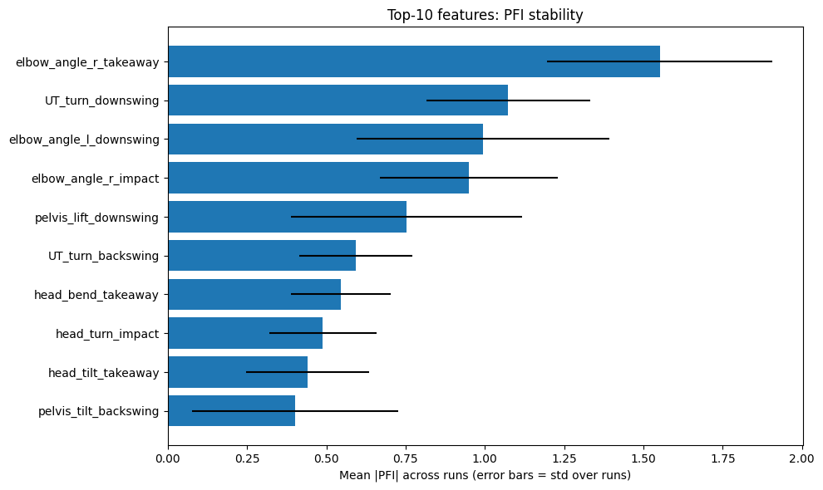
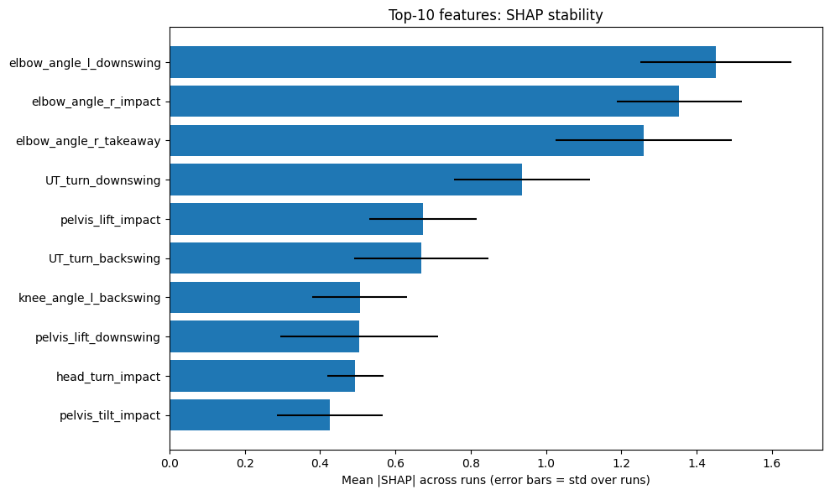
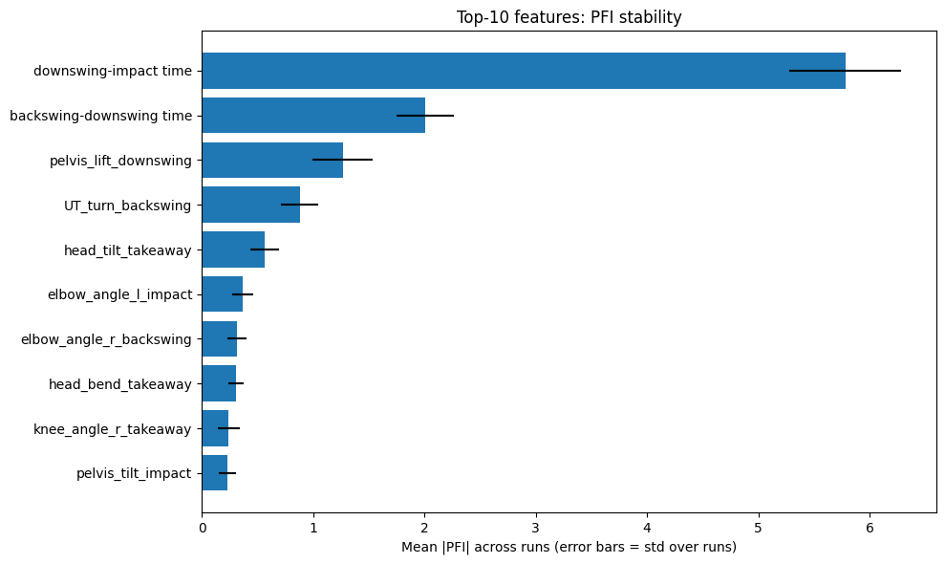
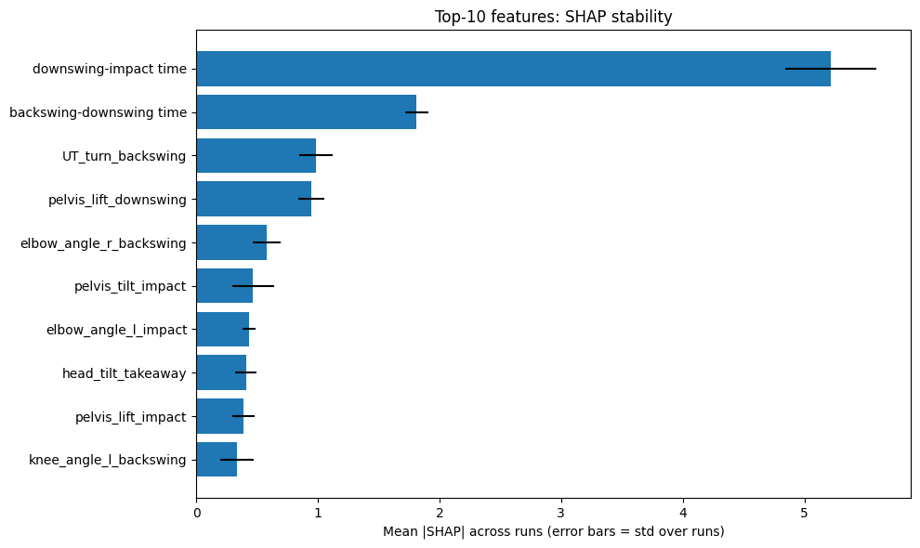
Supplement: Reliability

Slide 45
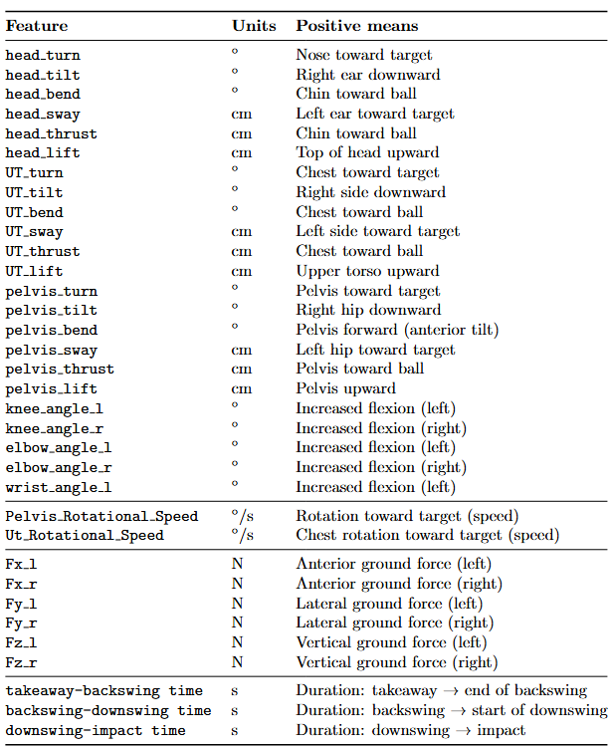
Supplement: All features

Slide 46
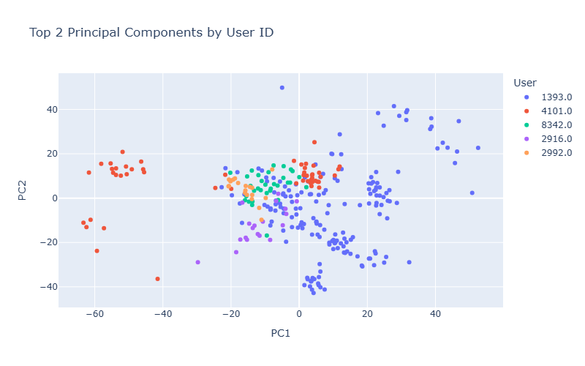
Supplement: PC space by user (B)

Slide 47
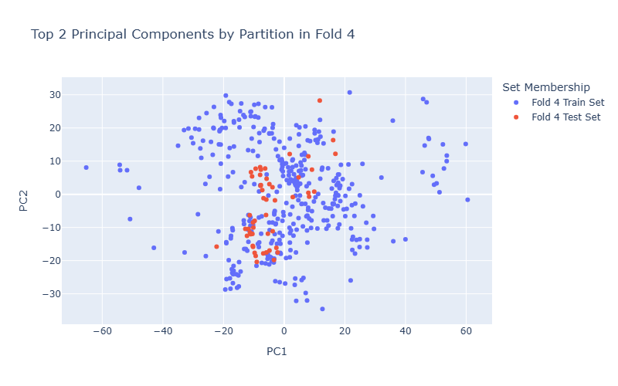
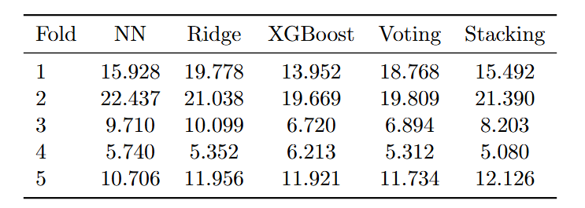
Supplement: Group degradation (no DR, B+T)

Slide 48
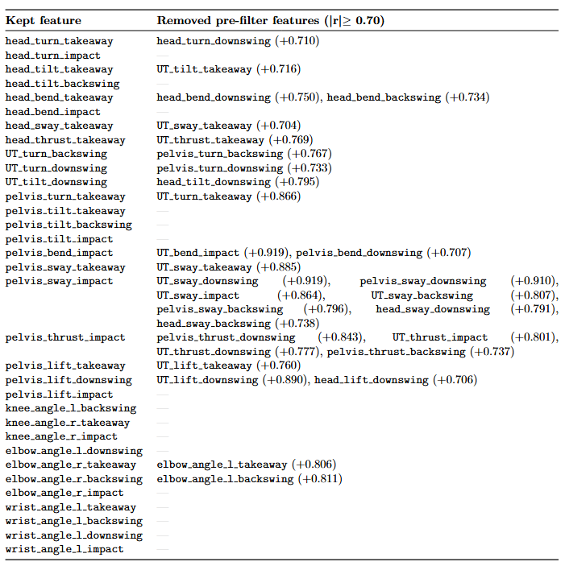
Supplement: Peered features

Slide 49
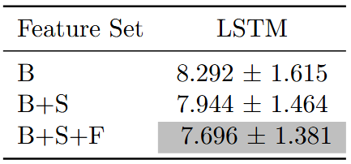
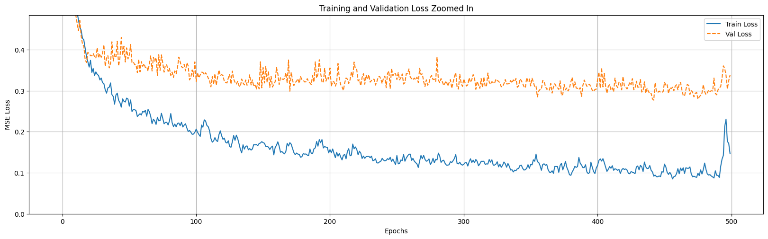
Supplement: LSTMs

Slide 50
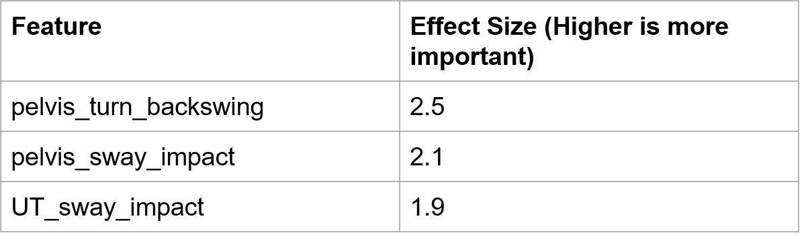
Supplement: Why VIF filter?
Clearly, “pelvis_turn_backswing” is the most important feature, right?

Slide 51
Supplement: Why VIF filter?
=4.0
Actually, in this case, the information jointly encoded by pelvis_sway_impact and UT_sway_impact is more important

Slide 52
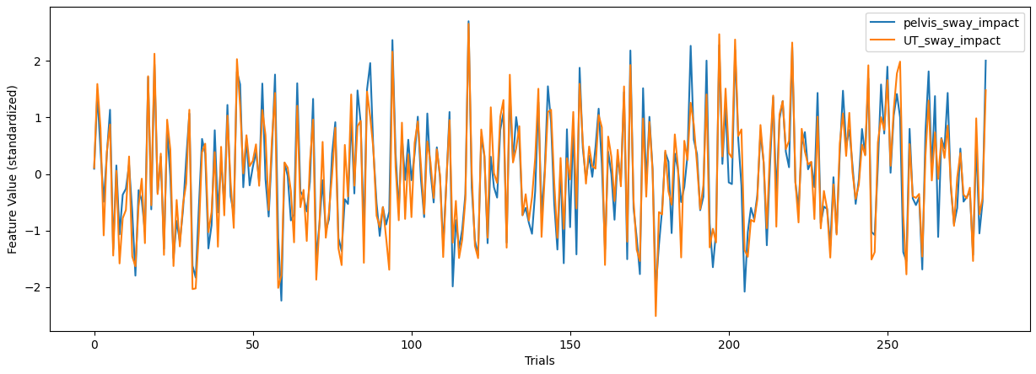
Supplement: Why VIF filter?
(Standardized)

Slide 53
Supplement: Why VIF filter?
Because pelvis_sway_impact and UT_sway_impact are highly correlated, a machine learning model may learn to use any arbitrary combination of the two features to predict outcomes, effectively hiding the importance of the underlying information they jointly encode

Slide 54
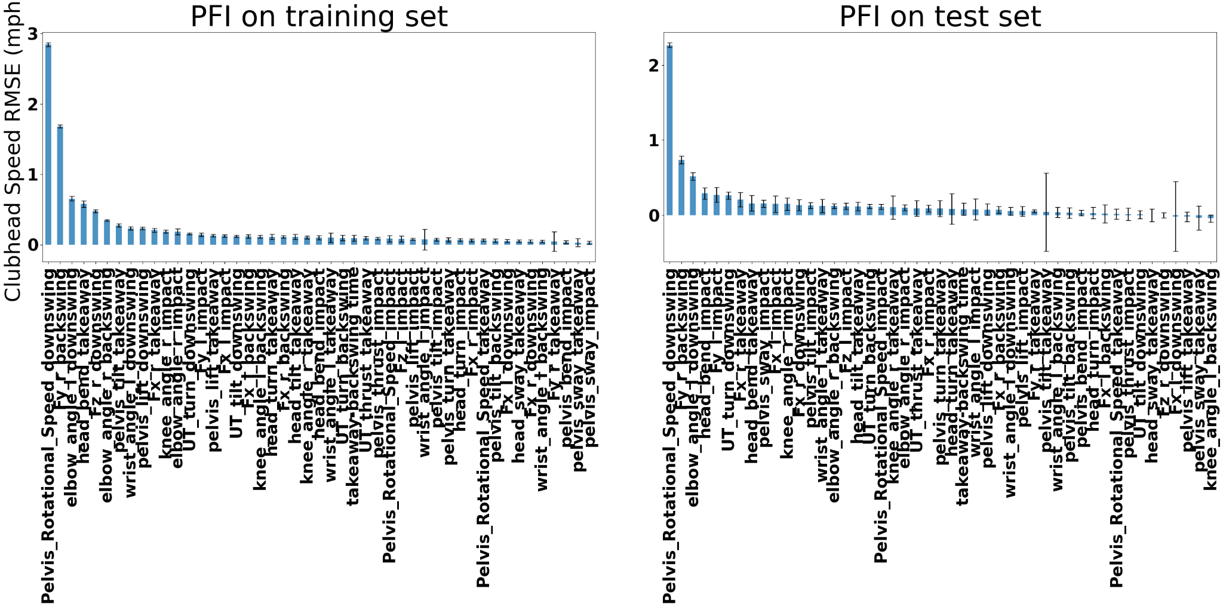
Supplement: B+T+S+F

Slide 55
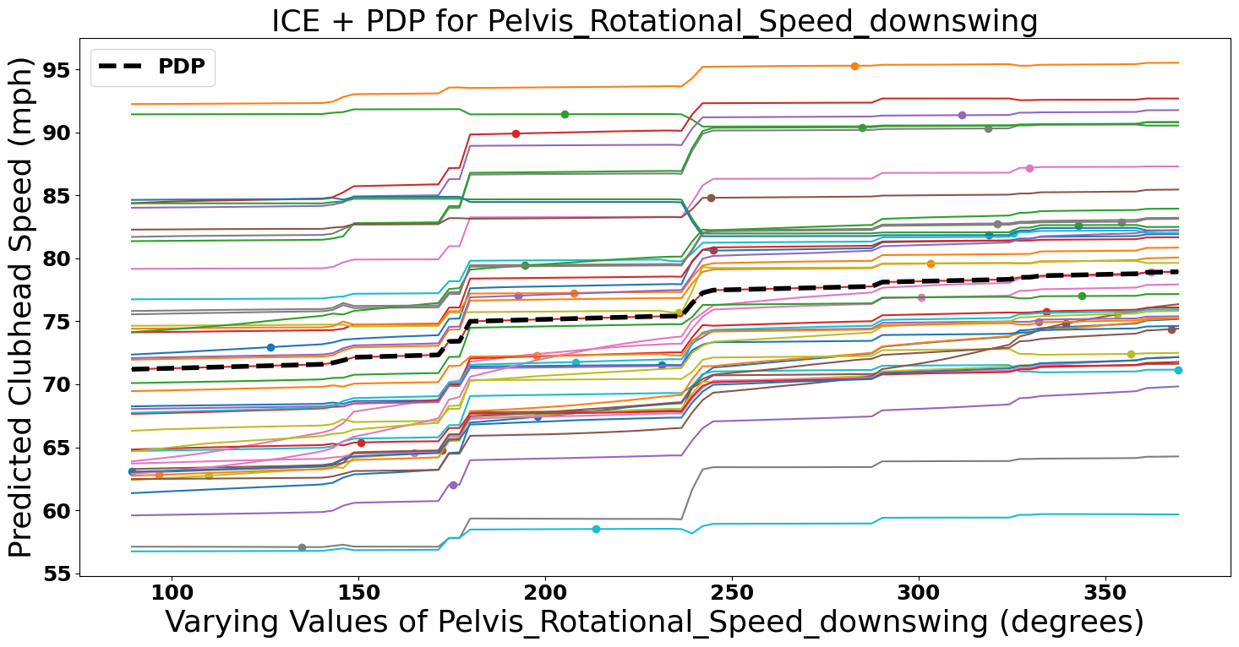
Supplement: B+T+S+F

Slide 56
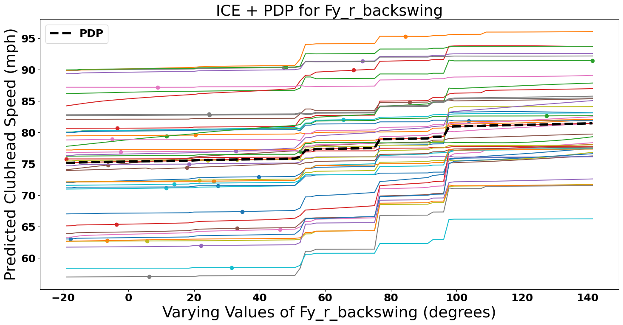
Supplement: B+T+S+F

Slide 57
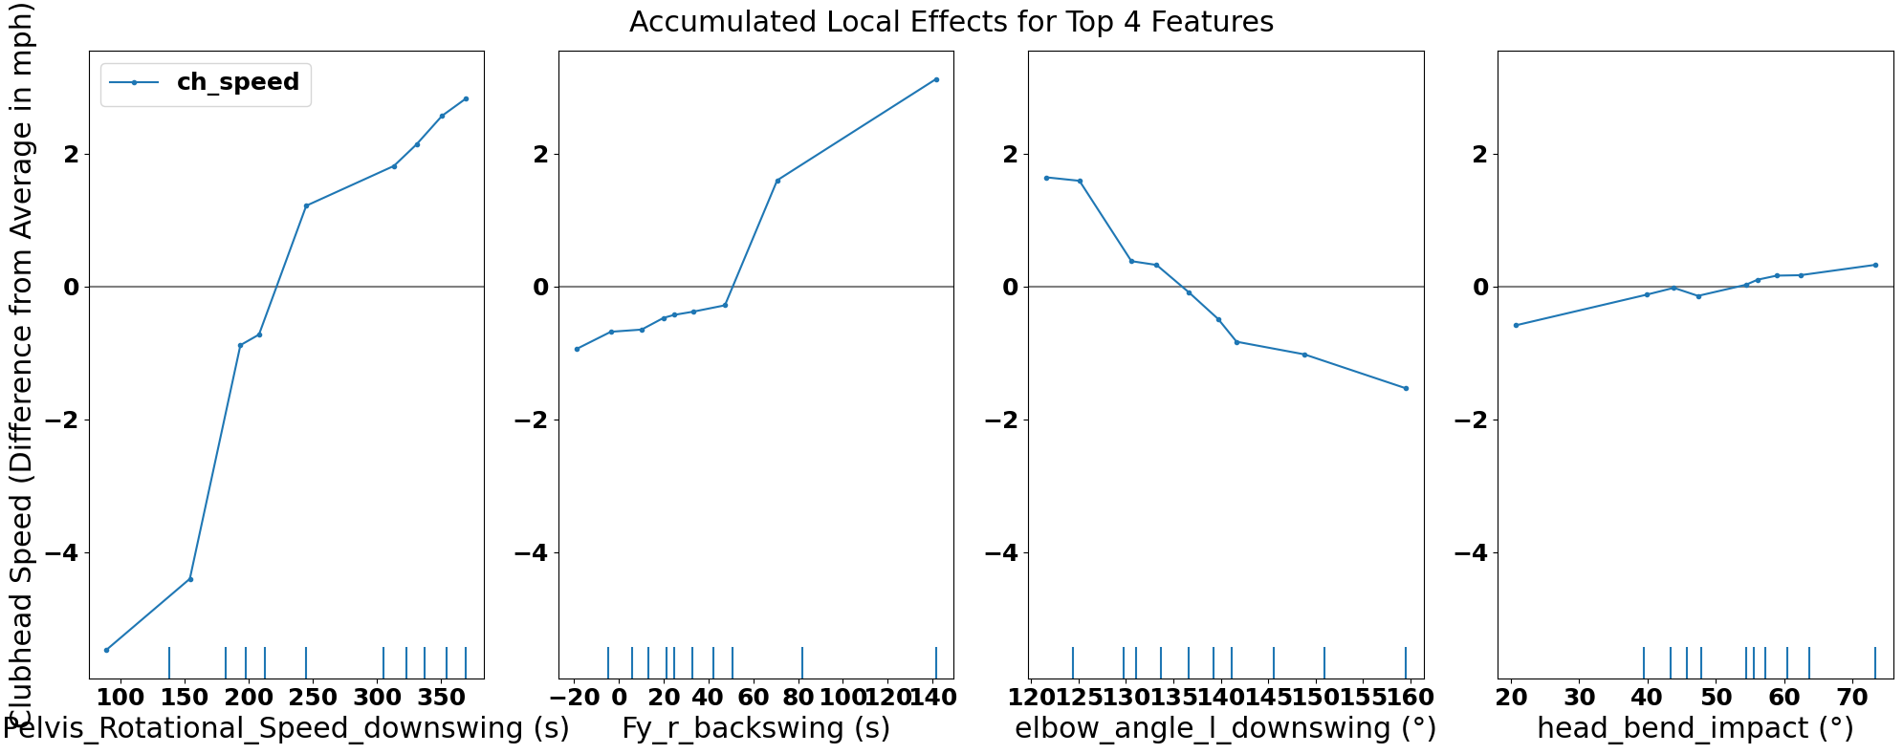
Supplement: B+T+S+F

Slide 58

Supplement: B+T+S+F

Slide 59

Thank you!

